Slide 1
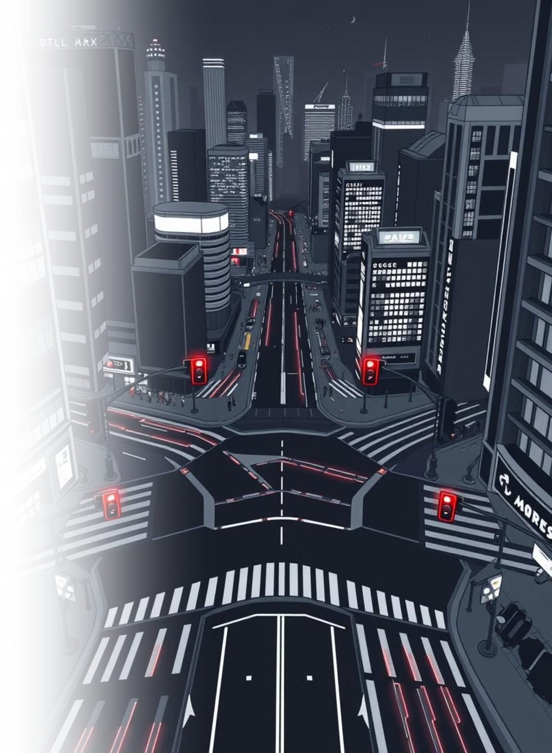
Smart Traffic Light: Surveillance & Execution Framework
Explore a state machine-driven four-way intersection with pedestrian priority and fault tolerance. Learn state machine design, timing control, UI event handling, and rendering with Raylib.

Slide 2
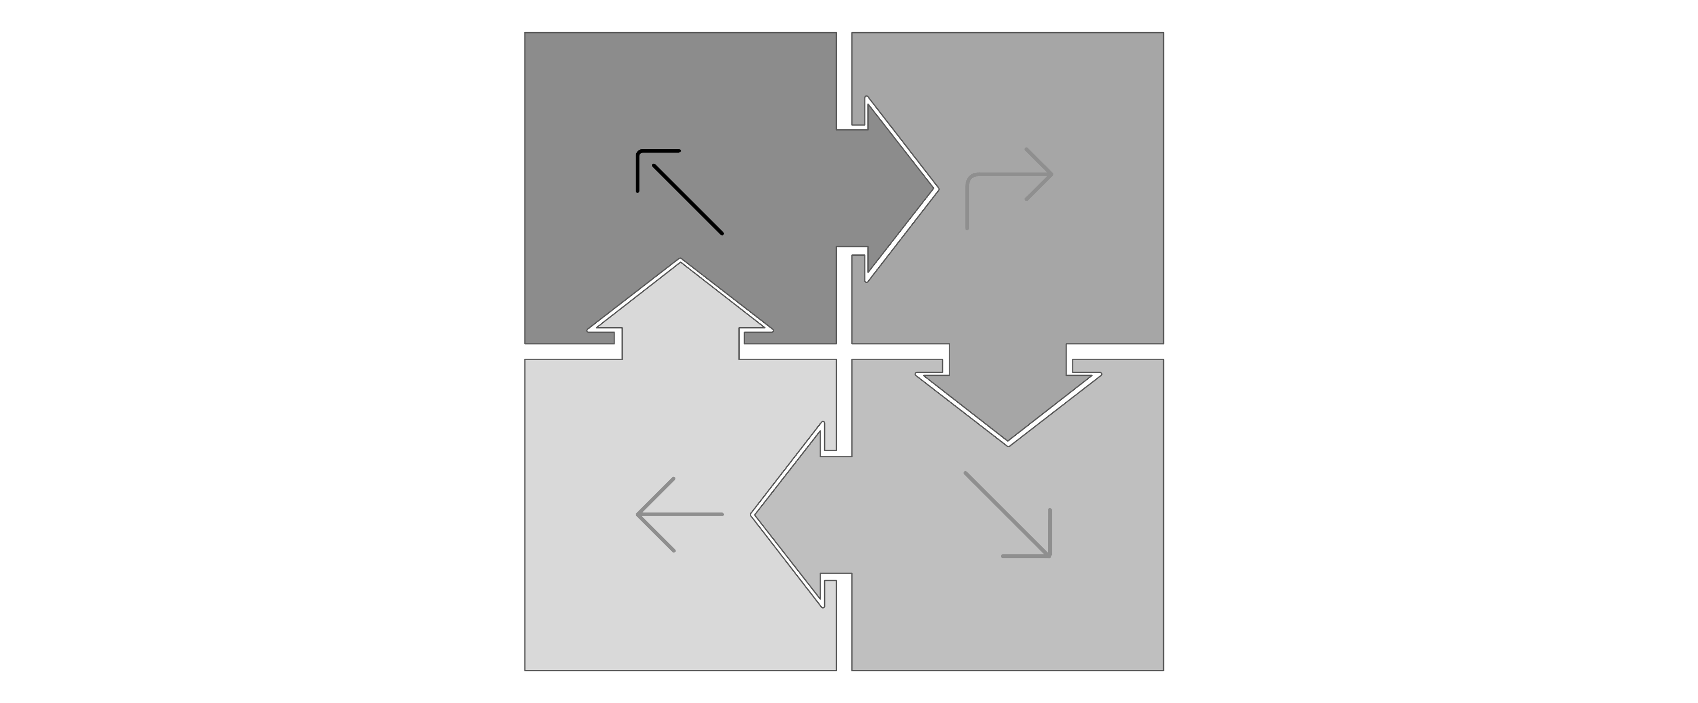




System Overview
Our simulation models a four-way intersection, ensuring only one direction is active at a time, cycling clockwise (North → East → South → West).
North
East
West
South
Normal Cycle: Standard light progression.
Pedestrian Override: A 5-second interruption for pedestrian crossing.
Faulty-Light Handling: Skips broken lights and accelerates timing.
Rendering: Powered by Raylib's efficient drawing loop.

Slide 3

Key Entities & Data Model
The simulation's core relies on well-defined states and objects for traffic light management.
IntersectionController
TLState Enum
TrafficLight Class
TLState enum: Defines light states: RED, YELLOW, GREEN, PEDESTRIAN, OFF.
TrafficLight class: Manages individual light properties (name, state, durations, timeLeft, healthy) and actions (tick(), setState()).
IntersectionController class: Orchestrates the intersection with timers, pedestrian flags, and helper functions like setOnlyGreen(), restoreCycleState(), hasAnyFault().

Slide 4
State Machine: Normal Cycle
Each direction operates through a two-phase cycle, ensuring a single GREEN light at all times.
Phase 0: GREEN
Advance
Current direction is GREEN; all others are RED.
Upon phase completion, advance clockwise to the next healthy direction.
1
2
3
Phase 1: YELLOW
Current direction turns YELLOW; all others remain RED.
Key principle: At any given moment, exactly one light is GREEN, maintaining traffic flow and safety.

Slide 5
Timing & Units
Precise timing is crucial for a realistic traffic flow, with all durations managed in milliseconds.
10000ms
3000ms
13000ms
Green Duration
Yellow Duration
Red Duration
Time for active traffic flow.
Transition warning period.
Waiting period for inactive directions.
All timers are in milliseconds for granular control.
dt = GetFrameTime() * 1000 ensures frame-rate independent updates.
Countdown behavior in tick() is implemented with clamping at 0 to prevent underflow.

Slide 6
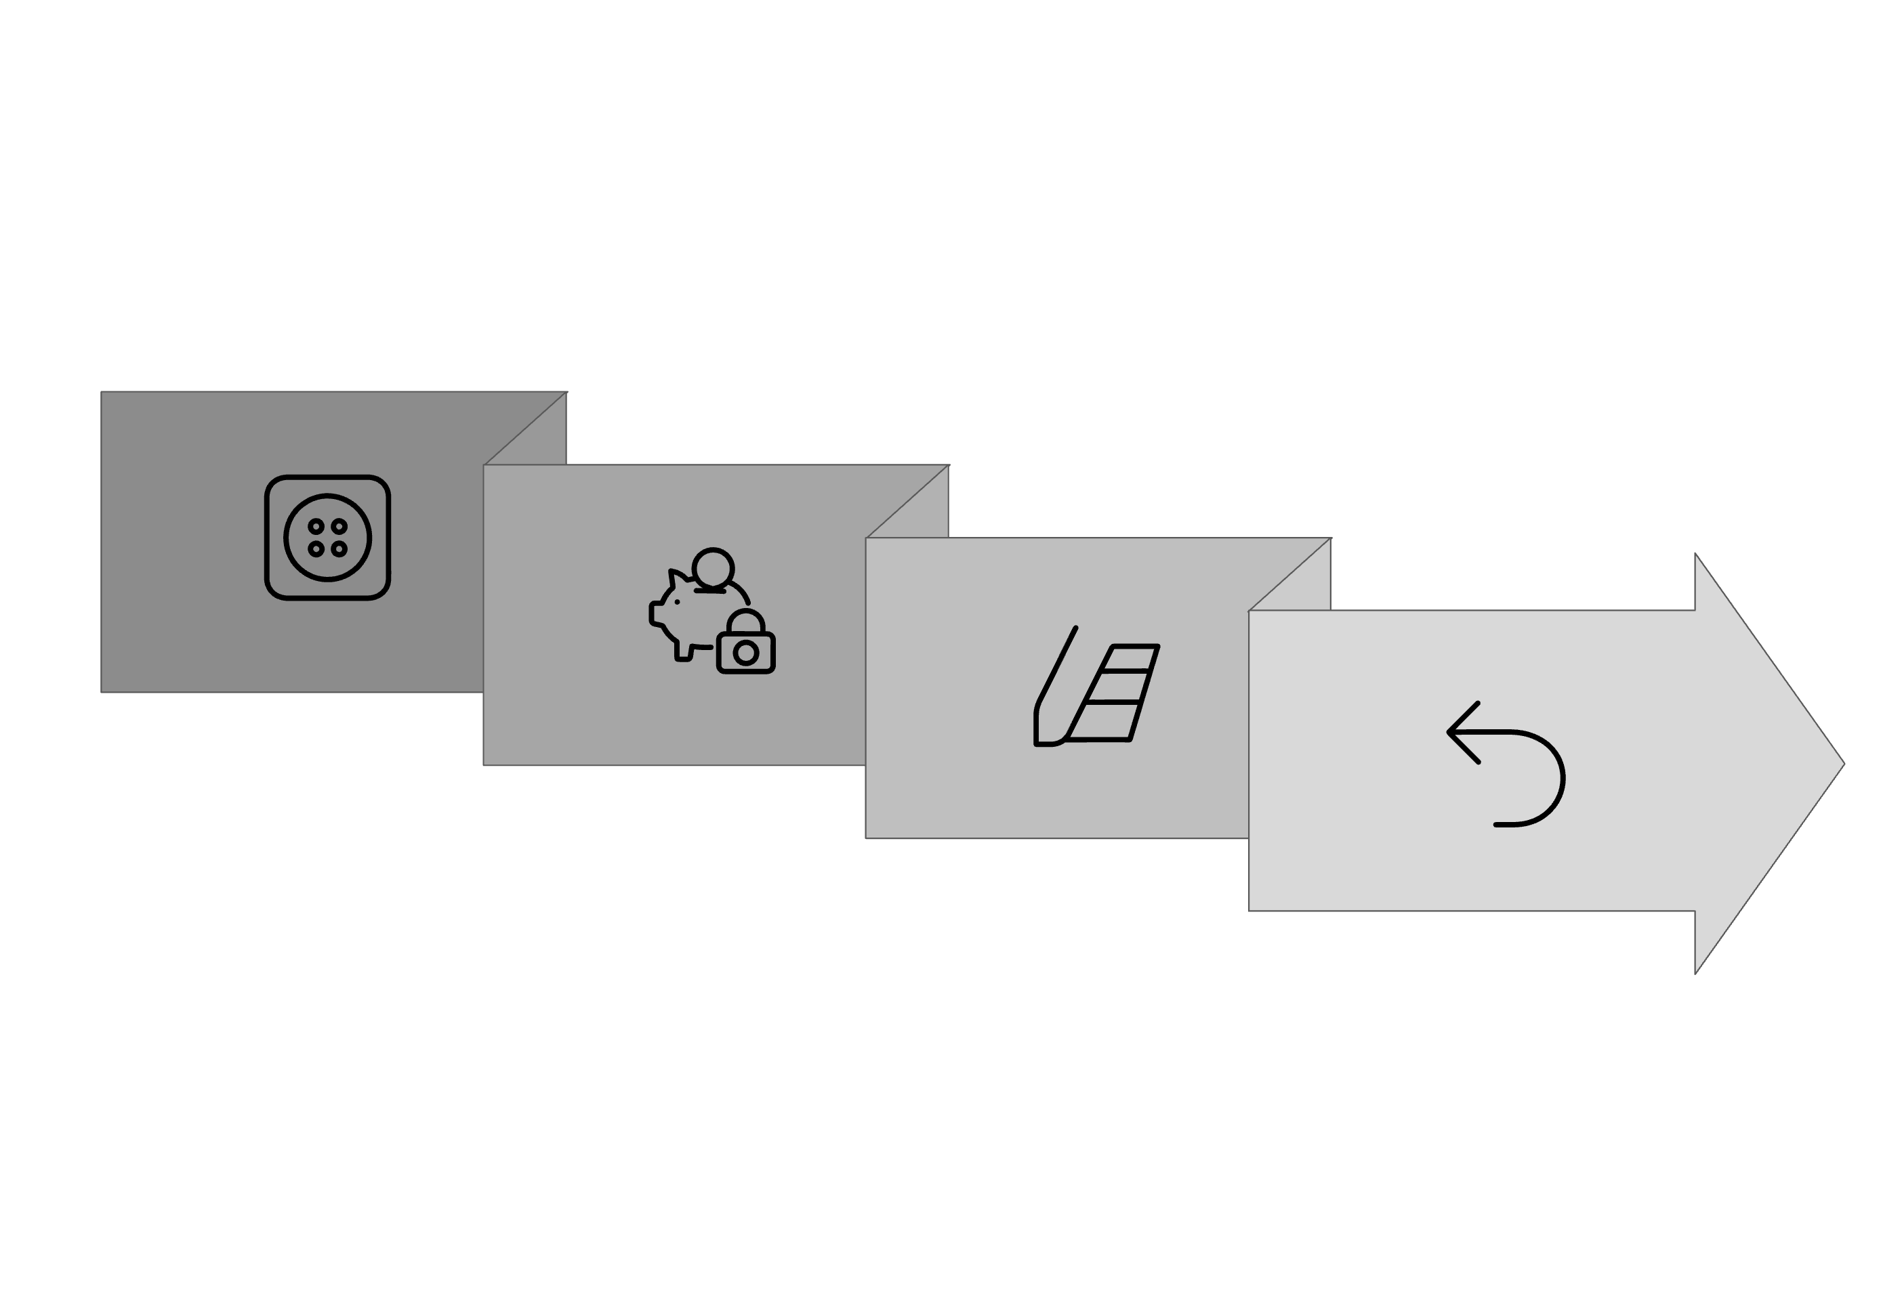




Pedestrian Mode: Override & Restore
Pedestrian mode offers a safe crossing interval, seamlessly interrupting and resuming the normal traffic cycle.
Save State
Restore
Trigger
Set Pedestrian
Triggered by clicking the "PED" button below a light.
Saves state: m_savedIdx, m_savedPhase, m_savedTimeLeft preserve the current cycle context.
For 5 seconds: The target direction turns dark green (PEDESTRIAN), while all others force RED.
After 5s: restoreCycleState() seamlessly resumes traffic flow from where it left off.

Slide 7



Fault Tolerance & Speed-Up
The system adapts to faulty lights by skipping them and accelerating the cycle, ensuring continuous operation.
Toggle Fault
Skip Faulty
Accelerated Cycle
Keys 1-4 toggle a direction's faulty state (N/E/S/W).
Faulty lights (isHealthy() == false) become OFF and are skipped.
If any light is faulty, speedFactor = 2 to avoid dead time.
Flow: Detect any fault → multiply dt by speedFactor → skip faulty lights during cycle advance.

Slide 8
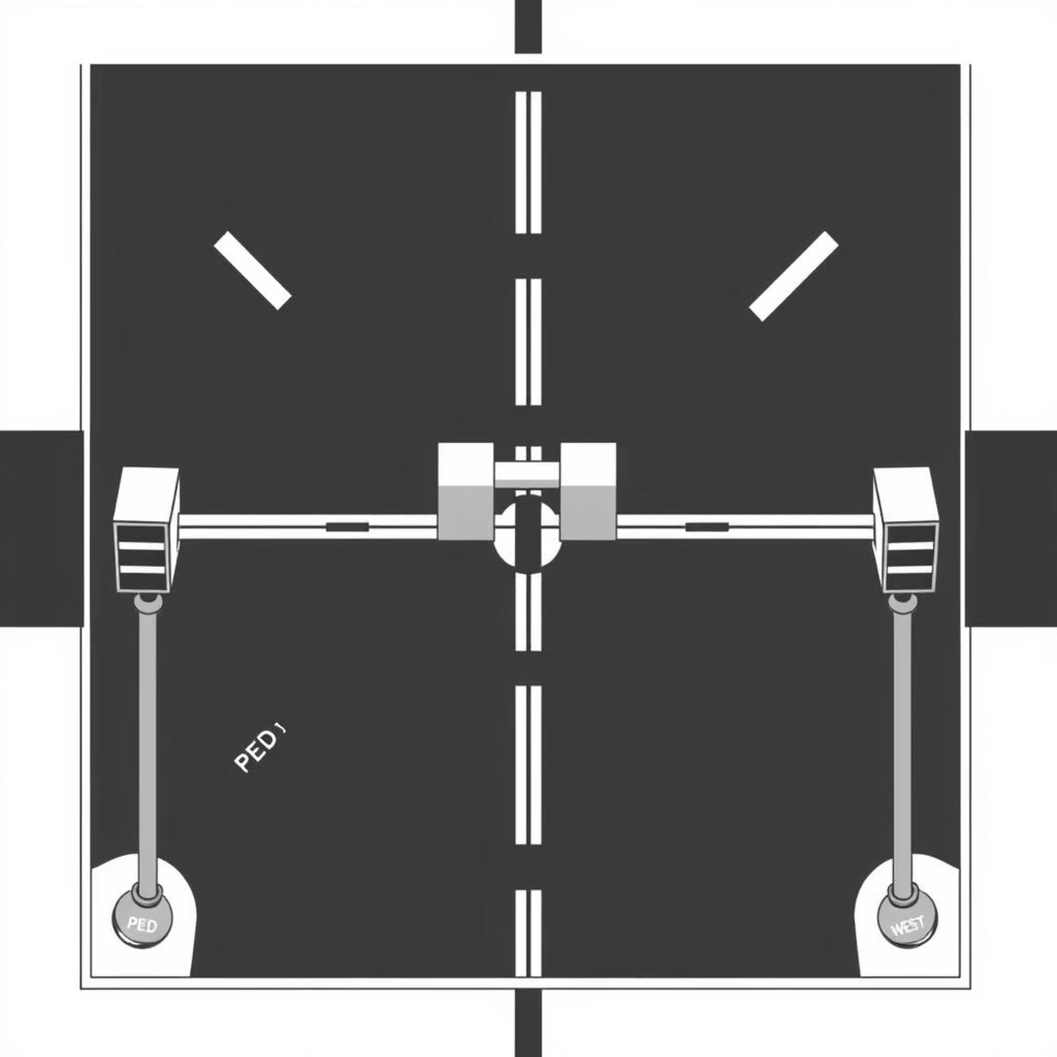
Event Handling & UI
The simulation features interactive controls and clear visual indicators for traffic light states and faults.
Inputs:
Mouse click: On any "PED" button (rectangle below each light).
Keyboard: Keys 1-4 toggle faulty states for N/E/S/W.
Drawing:
Each light as a vertical box with R/Y/G bulbs.
Countdown timer on healthy lights; "FAULT" label on faulty ones.
PEDESTRIAN mode uses dark green.

Slide 9
Core Algorithm: update(dt)
function update(dt): if m_pedestrianMode: m_pedestrianTimeLeft -= dt if m_pedestrianTimeLeft <= 0: restoreCycleState() m_pedestrianMode = false else: // Set pedestrian target light to PEDESTRIAN, others to RED setOnlyGreen(m_pedestrianTargetIdx, TLState.PEDESTRIAN) else: if hasAnyFault(): dt *= speedFactor currentLight = trafficLights[m_currentIdx] currentLight.timeLeft -= dt if currentLight.timeLeft <= 0: if m_phase == 0: // GREEN phase ends currentLight.setState(TLState.YELLOW) currentLight.timeLeft = currentLight.yellowMs m_phase = 1 else: // YELLOW phase ends // Advance to next healthy direction m_currentIdx = findNextHealthyDirection(m_currentIdx) m_phase = 0 // Reset to GREEN phase for new direction setOnlyGreen(m_currentIdx, TLState.GREEN)

Slide 10
Build & Run
To experience the Smart Traffic Light Simulation, ensure you have the necessary dependencies and follow these simple steps.
Requirements:
Run:
C++17 compatible compiler
./traffic_sim
Raylib 4.x library
Build (Linux/macOS Example):
Controls Recap:
Click "PED" below a direction: Activates 5-second pedestrian mode.
g++ main.cpp -o traffic_sim -lraylib -std=c++17
Press 1-4: Toggles FAULTY state for North, East, South, or West lights.

